Slide 1
July 2023
Core epidemiology slides

Slide 2
Global estimates for adults and children  2022
People living with HIV 39.0 million [33.1 million–45.7 million]
New HIV infections 1.3 million [1.0 million–1.7 million]
Deaths due to AIDS 630 000 [480 000–880 000]

Slide 3
About 3600 new HIV infections (adults and children) a day  2022
About 50% are in sub-Saharan Africa
About 360 are among children under 15 years of age
About 3200 are among adults aged 15 years and older, of whom:
─ almost 46% are among women
─ about 30% are among young people (15–24)
─ about 18% are among young women (15–24)

Slide 4
Global estimates for children (<15 years)  2022
Children living with HIV 1.5 million [1.2 million–2.1 million]
New HIV infections 130 000 [90 000–210 000]
Deaths due to AIDS 84 000 [56 000–120 000]

Slide 5
Regional HIV and AIDS statistics and features  2022
Adults and children living with HIV
Adults and children newly infected with HIV
Adult and child
deaths due to AIDS
Eastern and southern Africa
20.8 million
[17.4 million–24.5 million]
500 000
[370 000–670 000]
260 000
[200 000–370 000]
Western and central Africa
4.8 million
[4.2 million–5.5 million]
160 000
[110 000–250 000]
120 000
[96 000–160 000]
Middle East and North Africa
190 000
[160 000–220 000]
17 000
[13 000–23 000]
5300
[4000–7100]
Asia and the Pacific
6.5 million
[5.3 million–7.8 million]
300 000
[220 000–400 000]
150 000
[110 000–220 000]
Latin America
2.2 million
[2.0 million–2.5 million]
110 000
[94 000–130 000]
27 000
[21 000–35 000]
Caribbean
330 000
[290 000–380 000]
16 000
[11 000–21 000]
5600
[4100– 7500]
Eastern Europe and central Asia
2.0 million
[1.8 million–2.1 million]
160 000
[140 000–180 000]
48 000
[38 000–58 000]
Western and central Europe and
North America
2.3 million
[1.9 million–2.6 million]
58 000
[46 000–69 000]
13 000
[9300–17 000]
GLOBAL
39.0 million
[33.1 million–45.7 million]
1.3 million
[1.0 million–1.7 million]
630 000
[480 000–880 000]
The ranges around the estimates in this table define the boundaries within which the actual numbers lie, based on the best available information.

Slide 6
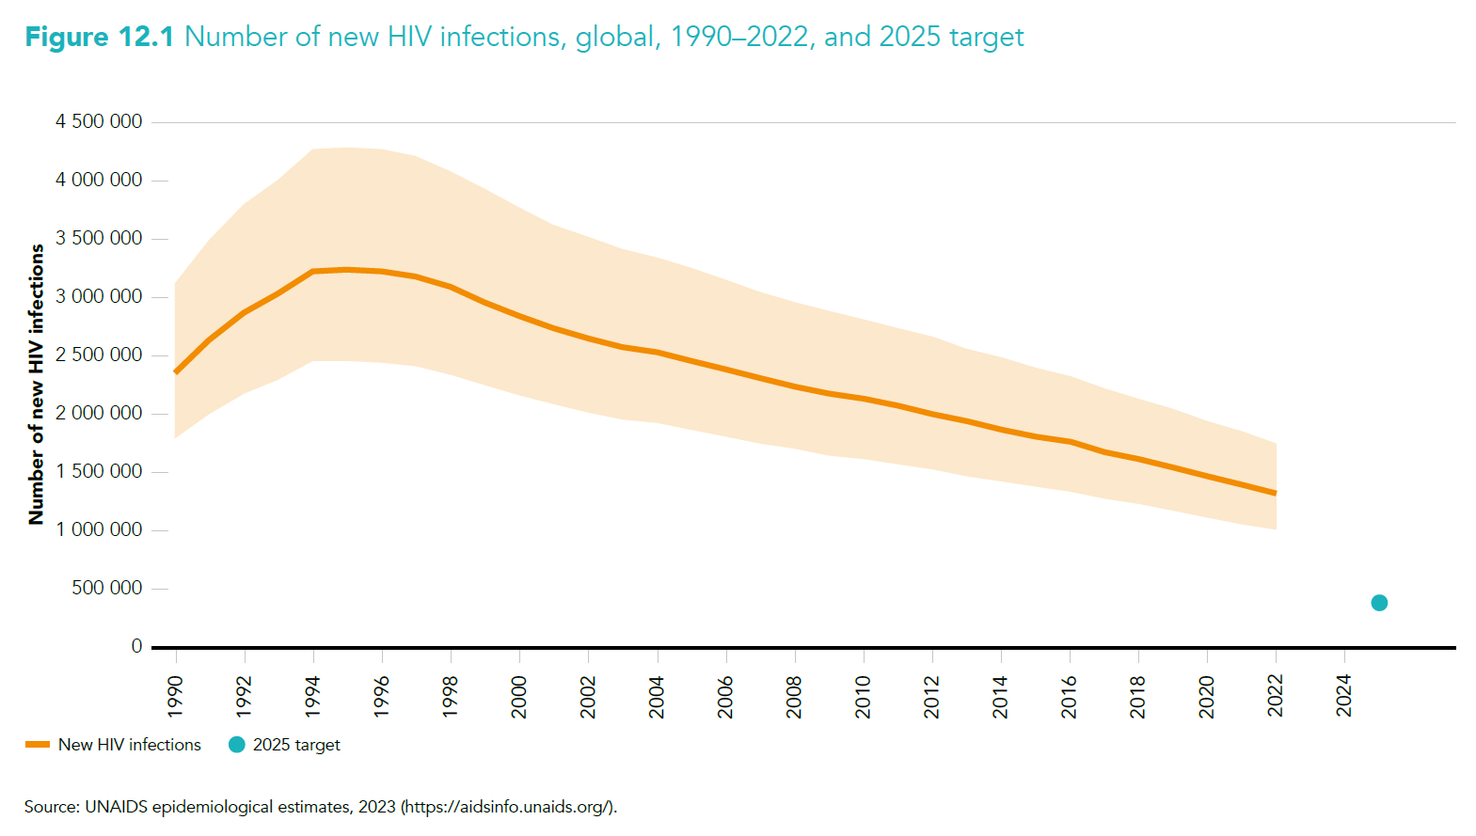

Slide 7
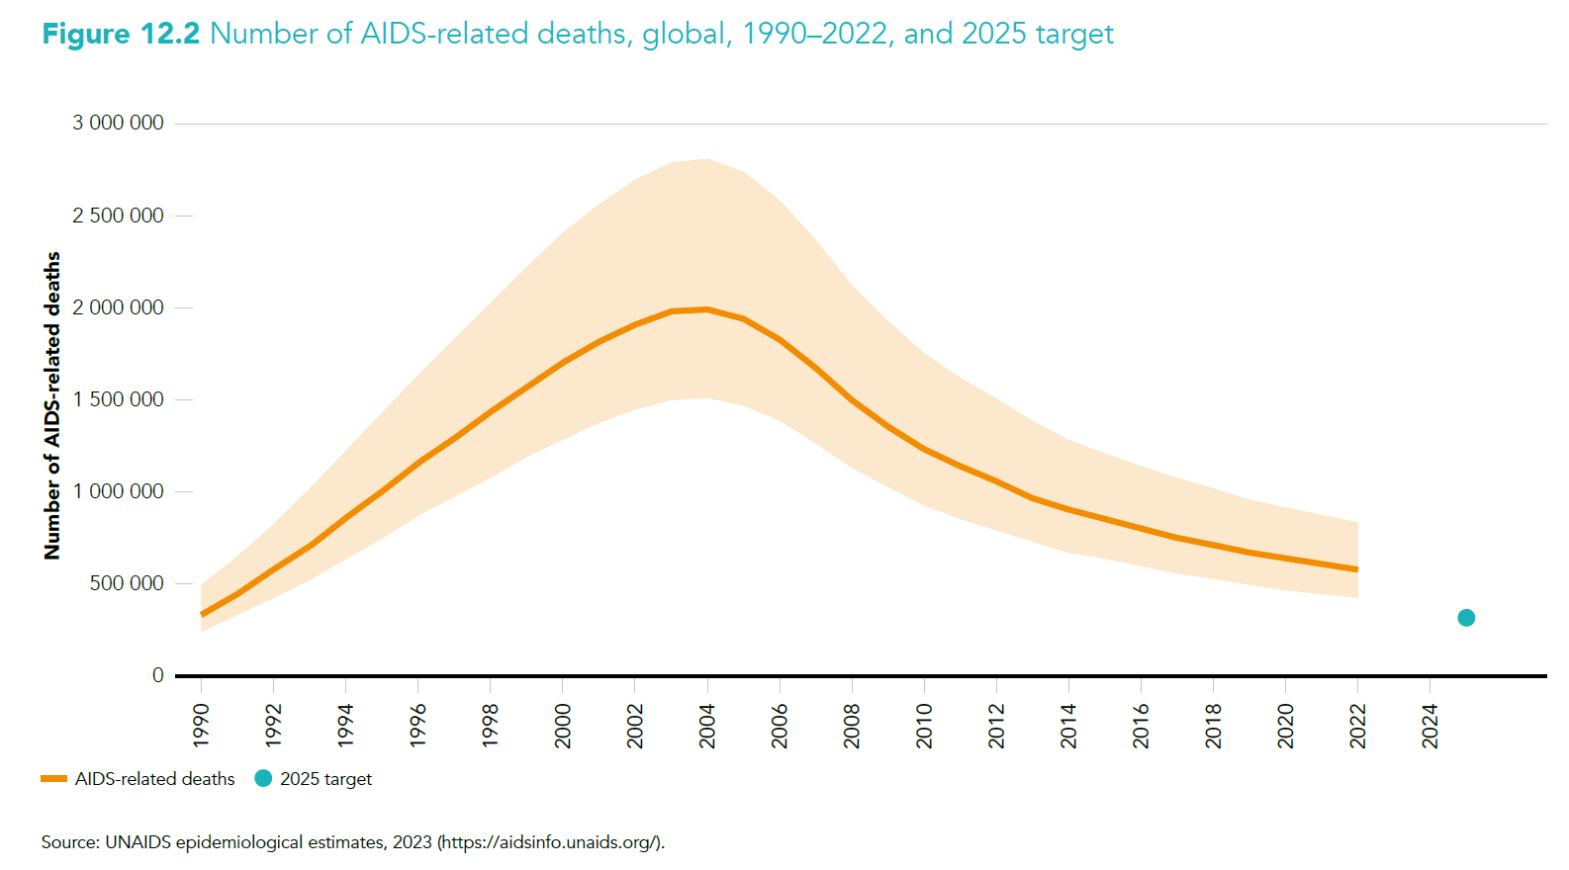

Slide 8
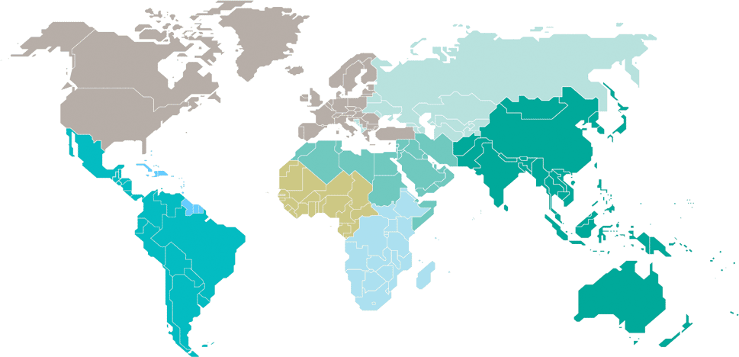
Adults and children estimated to be living with HIV  2022
Eastern Europe and central Asia
2.0 million
[1.8 million–2.1 million]
North America and western and central Europe
2.3 million
[1.9 million–2.6 million]
Caribbean
330 000
[290 000–380 000]
Middle East and North Africa
190 000
[160 000–220 000]
Western and central Africa
4.8 million
[4.2 million–5.5 million]
Asia and the Pacific
6.5 million
[5.3 million–7.8 million]
Latin America
2.2 million
[2.0 million–2.5 million]
Eastern and southern Africa
20.8 million
[17.4 million–24.5 million]
Total: 39.0 million [33.1 million–45.7 million]

Slide 9
Estimated number of adults and children newly infected with HIV  2022
Eastern Europe and central Asia
160 000
[140 000–180 000]
North America and western and central Europe
58 000
[46 000–69 000]
Caribbean
16 000
[11 000–21 000]
Middle East and North Africa
17 000
[13 000–23 000]
Western and central Africa
160 000
[110 000–250 000]
Asia and the Pacific
300 000
[220 000–400 000]
Latin America
110 000
[94 000–130 000]
Eastern and southern Africa
500 000
[370 000–670 000]
Total: 1.3 million [1.0 million–1.7 million]

Slide 10
Estimated adult and child deaths from AIDS  2022
Eastern Europe and central Asia
48 000
[38 000–58 000]
North America and western and central Europe
13 000
[9300–17 000]
Caribbean
5600
[4100–7500]
Middle East and North Africa
5300
[4000–7100]
Western and central Africa
120 000
[96 000–160 000]
Asia and the Pacific
150 000
[110 000–220 000]
Latin America
27 000
[21 000–35 000]
Eastern and southern Africa
260 000
[200 000–370 000]
Total: 630 000 [480 000–880 000]

Slide 11
Children (<15 years) estimated to be living with HIV  2022
Eastern Europe and central Asia
…*
North America and western and central Europe
…*
Caribbean
11 000
[8600–13 000]
Middle East and North Africa
10 000
[8700–12 000]
Western and central Africa
400 000
[310 000–490 000]
Asia and the Pacific
130 000
[110 000–160 000]
Latin America
31 000
[26 000–36 000]
Eastern and southern Africa
930 000
[710 000–1.4 million]
*Estimates for children are not published because of small numbers.
Total: 1.5 million [1.2 million–2.1 million]

Slide 12
Estimated number of children (<15 years) newly infected with HIV  2022
Eastern Europe and central Asia
…*
North America and western and central Europe
…*
Caribbean
1500
[1100 – 2100]
Middle East and North Africa
1700
[1300–2100]
Western and central Africa
51 000
[33 000–69 000]
Asia and the Pacific
12 000
[8600–18 000]
Latin America
3800
[2900–4700]
Eastern and southern Africa
58 000
[38 000–100 000]
*Estimates for children are not published because of small numbers.
Total: 130 000 [90 000–210 000]

Slide 13
Estimated deaths in children (<15 years) from AIDS  2022
Eastern Europe and central Asia
…*
North America and western and central Europe
…*
Caribbean
870
[540 – 1200]
Middle East and North Africa
1000
[820–1300]
Western and central Africa
34 000
[24 000–46 000]
Asia and the Pacific
7500
[4700–11 000]
Latin America
2700
[2000–3300]
Eastern and southern Africa
35 000
[22 000–55 000]
*Estimates for children are not published because of small numbers.
Total: 84 000 [56 000–120 000]

