Slide 1
July 2021
Core epidemiology slides

Slide 2
Global summary of the AIDS epidemic  2020
Number of people living with HIV
Total
Adults
Women (15+ years)
Children (<15 years)
Total
Adults
Women (15+ years)
Children (<15 years)
Total
Adults
Women (15+ years)
Children (<15 years)
37.7 million [30.2 million–45.1 million]
36.0 million [28.9 million–43.2 million] 19.3 million [15.5 million–23.1 million]
1.7 million [1.2 million–2.2 million]
1.5 million [1.0 million–2.0 million] 1.3 million [910 000–1.8 million]
660 000 [450 000–920 000]
150 000 [100 000–240 000]
680 000 [480 000–1.0 million]
580 000 [400 000–850 000]
240 000 [170 000–360 000]
99 000 [68 000–160 000]
People newly infected
with HIV in 2020
AIDS-related deaths in 2020
Source: UNAIDS 2021 epidemiological estimates.

Slide 3
Every day there are 4000 new HIV infections (adults and children)  2020
60% are in sub-Saharan Africa
10% are among children under 15 years of age
90% are among adults aged 15 years and older, of whom:
─ 51% are among women
─ 31% are among young people (15–24)
─ 20% are among young women (15–24)
Source: UNAIDS 2021 epidemiological estimates.

Slide 4
Regional HIV and AIDS statistics and features  2020
Adults and children living with HIV
Adults and children newly infected with HIV
Adult and child
deaths due to AIDS
Eastern and southern Africa
20.6 million
[16.8 million–24.4 million]
670 000
[470 000–930 000]
310 000
[220 000–470 000]
Western and central Africa
4.7 million
[3.9 million–5.8 million]
200 000
[130 000–330 000]
150 000
[100 000–210 000]
Middle East and North Africa
230 000
[190 000–310 000]
16 000
[12 000–28 000]
7900
[6000–13 000]
Asia and the Pacific
5.8 million
[4.3 million–7.0 million]
240 000
[170 000–310 000]
130 000
[87 000–200 000]
Latin America
2.1 million
[1.4 million–2.7 million]
100 000
[66 000–150 000]
31 000
[20 000–46 000]
Caribbean
330 000
[280 000–390 000]
13 000
[8700–18 000]
6000
[4300–8500]
Eastern Europe and central Asia
1.6 million
[1.5 million–1.8 million]
140 000
[120 000–160 000]
35 000
[28 000–43 000]
Western and central Europe and
North America
2.2 million
[1.9 million–2.6 million]
67 000
[53 000–81 000]
13 000
[9200–17 000]
GLOBAL
37.7 million
[30.2 million–45.1 million]
1.5 million
[1.0 million–2.0 million]
680 000
[480 000–1.0 million]
The ranges around the estimates in this table define the boundaries within which the actual numbers lie, based on the best available information.
Source: UNAIDS 2021 epidemiological estimates.

Slide 5
Adults and children estimated to be living with HIV  1990–2020
Adults and children estimated to be living with HIV
Range of uncertainty
Source: UNAIDS 2021 epidemiological estimates.

Slide 6
Adults and children newly infected with HIV 1990–2020
Adults and children newly infected with HIV
Range of uncertainty
Source: UNAIDS 2021 epidemiological estimates.

Slide 7
Adult and child deaths due to AIDS  1990–2020
Adult and child deaths due to AIDS
Range of uncertainty
Source: UNAIDS 2021 epidemiological estimates.

Slide 8
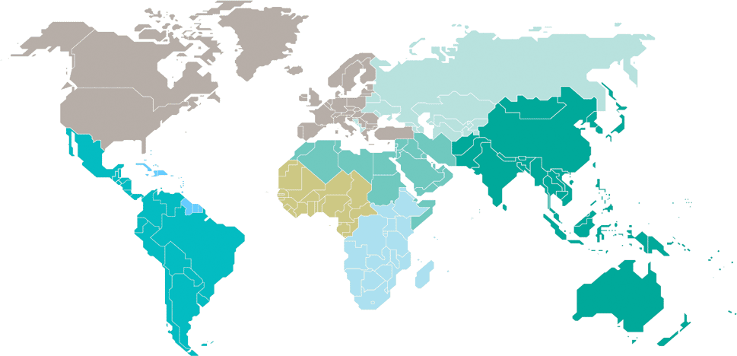
Adults and children estimated to be living with HIV  2020
Eastern Europe and central Asia
1.6 million
[1.5 million–1.8 million]
North America and western and central Europe
2.2 million
[1.9 million–2.6 million]
Caribbean
330 000
[280 000–390 000]
Middle East and North Africa
230 000
[190 000–310 000]
Western and central Africa
4.7 million
[3.9 million–5.8 million]
Asia and the Pacific
5.8 million
[4.3 million–7.0 million]
Latin America
2.1 million
[1.4 million–2.7 million]
Eastern and southern Africa
20.6 million
[16.8 million–24.4 million]
Total: 37.7 million [30.2 million–45.1 million]
Source: UNAIDS 2021 epidemiological estimates.

Slide 9
Estimated number of adults and children newly infected with HIV  2020
Eastern Europe and central Asia
140 000
[120 000–160 000]
North America and western and central Europe
67 000
[53 000–81 000]
Caribbean
13 000
[8700–18 000]
Middle East and North Africa
16 000
[12 000–28 000]
Western and central Africa
200 000
[130 000–330 000]
Asia and the Pacific
240 000
[170 000–310 000]
Latin America
100 000
[66 000–150 000]
Eastern and southern Africa
670 000
[470 000–930 000]
Total: 1.5 million [1.0 million–2.0 million]
Source: UNAIDS 2021 epidemiological estimates.

Slide 10
Estimated adult and child deaths from AIDS  2020
Eastern Europe and central Asia
35 000
[28 000–43 000]
North America and western and central Europe
13 000
[9200–17 000]
Caribbean
6000
[4300–8500]
Middle East and North Africa
7900
[6000–13 000]
Western and central Africa
150 000
[100 000–210 000]
Asia and the Pacific
130 000
[87 000–200 000]
Latin America
31 000
[20 000–46 000]
Eastern and southern Africa
310 000
[220 000–470 000]
Total: 680 000 [480 000–1.0 million]
Source: UNAIDS 2021 epidemiological estimates.

Slide 11
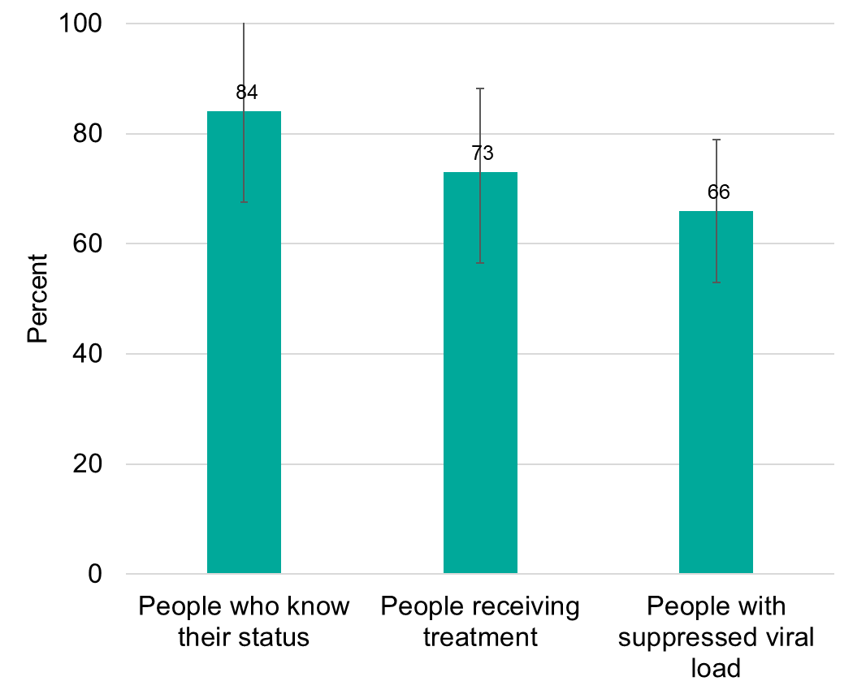
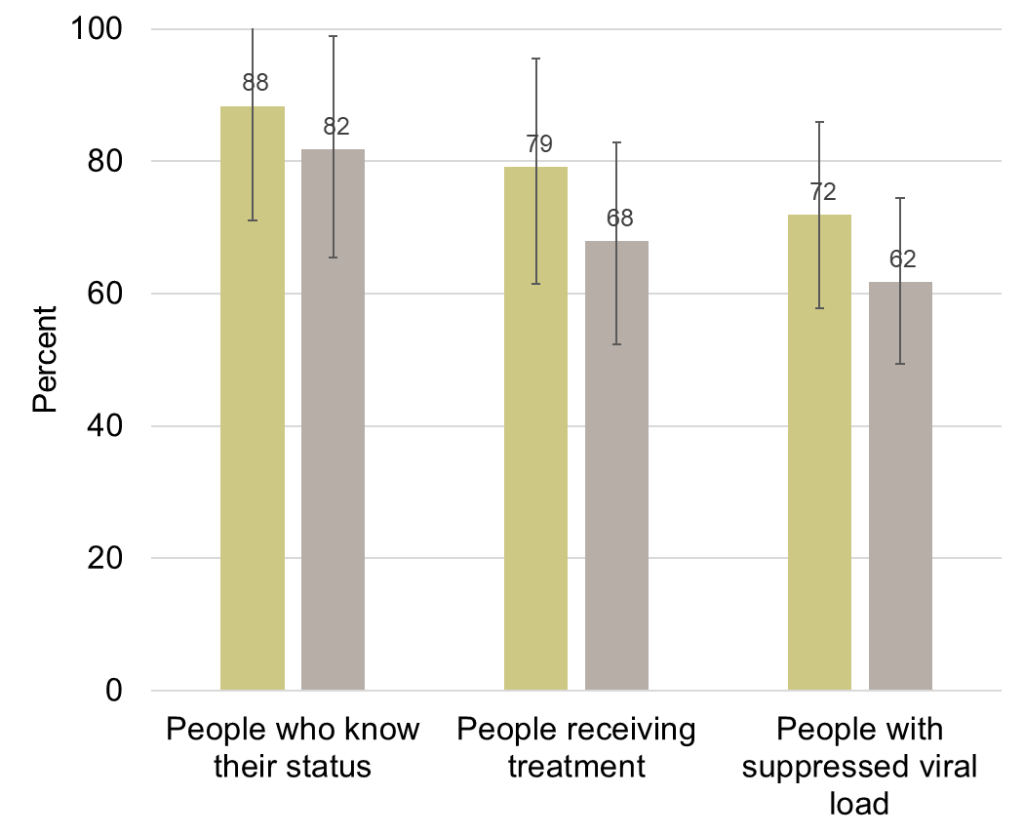
Among people living with HIV, the percent who know their HIV-positive status, are receiving treatment and are virally suppressed 2020
Total population
Women and men (15+ years)
Women
Men
Source: UNAIDS 2021 epidemiological estimates.

