Slide 1
July 2024
Core epidemiology slides

Slide 2
Global estimates for adults and children  2023
People living with HIV 39.9 million [36.1 million–44.6 million]
New HIV infections 1.3 million [1.0 million–1.7 million]
Deaths due to AIDS 630 000 [500 000–820 000]

Slide 3
About 3600 new HIV infections (adults and children) a day  2023
About 50% are in sub-Saharan Africa
About 320 are among children under 15 years of age
About 3200 are among adults aged 15 years and older, of whom:
─ almost 44% are among women
─ about 30% are among young people (15–24)
─ about 17% are among young women (15–24)

Slide 4
Global estimates for children (<15 years)  2023
Children living with HIV 1.4 million [1.1 million–1.7 million]
New HIV infections 120 000 [83 000–170 000]
Deaths due to AIDS 76 000 [53 000–110 000]

Slide 5
Regional HIV and AIDS statistics and features  2023
Adults and children living with HIV
Adults and children newly infected with HIV
Adult and child
deaths due to AIDS
Eastern and southern Africa
20.8 million
[19.2 million–23.0 million]
450 000
[360 000–580 000]
260 000
[210 000–330 000]
Western and central Africa
5.1 million
[4.5 million–5.9 million]
190 000
[130 000–280 000]
130 000
[100 000–170 000]
Middle East and North Africa
210 000
[170 000–280 000]
23 000
[16 000–35 000]
6200
[4100–9400]
Asia and the Pacific
6.7 million
[6.1 million–7.5 million]
300 000
[270 000–370 000]
150 000
[110 000–200 000]
Latin America
2.3 million
[2.1 million–2.6 million]
120 000
[97 000–150 000]
30 000
[27 000–42 000]
Caribbean
340 000
[280 000–390 000]
15 000
[9900–21 000]
5100
[3500– 7400]
Eastern Europe and central Asia
2.1 million
[1.9 million–2.3 million]
140 000
[120 000–160 000]
44 000
[35 000–54 000]
Western and central Europe and
North America
2.3 million
[2.0 million–2.7 million]
56 000
[45 000–67 000]
13 000
[9400–17 000]
GLOBAL
39.9 million [36.1 million – 44.6 million]
1.3 million
[1.0 million–1.7 million]
630 000
[500 000–820 000]
The ranges around the estimates in this table define the boundaries within which the actual numbers lie, based on the best available information.

Slide 6
Number of new HIV infections, global, 1990–2023, and 2025 target
Source: UNAIDS 2024 epidemiological estimates

Slide 7
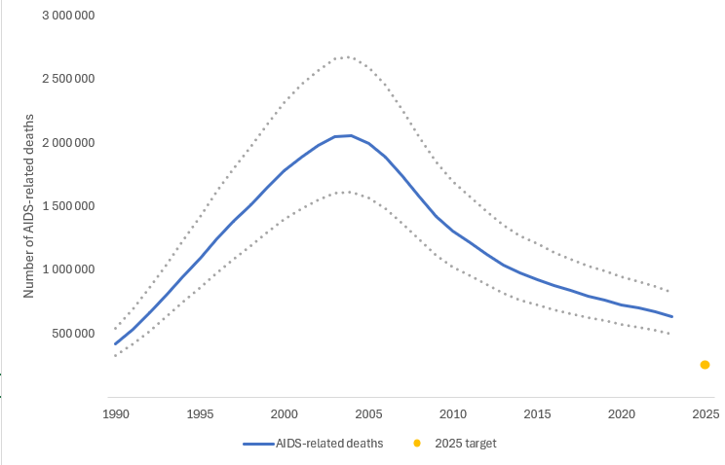
Number of AIDS-related deaths, global, 1990–2023, and 2025 target
Source: UNAIDS 2024 epidemiological estimates

Slide 8
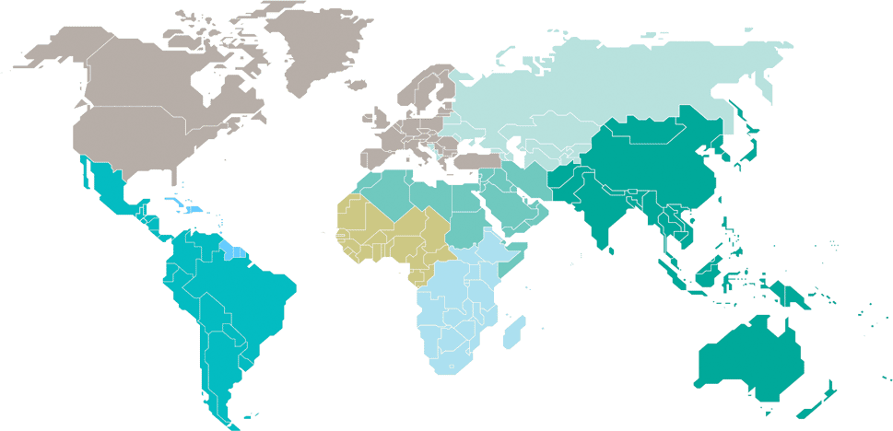
Adults and children estimated to be living with HIV  2023
Eastern Europe and 1entral Asia
2.1 million
[1.9 million–2.3 million]
North America and western and central Europe
2.3 million
[2.0 million–2.7 million]
Caribbean
340 000
[280 000–390 000]
Middle East and North Africa
210 000
[170 000–280 000]
Western and central Africa
5.1 million
[4.5 million–5.9 million]
Asia and the Pacific
6.7 million
[6.0 million–7.5 million]
Latin America
2.3 million
[2.0 million–2.5 million]
Eastern and southern Africa
20.8 million
[19.2 million–23.0 million]
Total: 39.9 million [36.1 million–44.6 million]

Slide 9
Estimated number of adults and children newly infected with HIV  2023
Eastern Europe and central Asia
140 000
[120 000–160 000]
North America and western and central Europe
56 000
[45 000–67 000]
Caribbean
15 000
[99000–21 000]
Middle East and North Africa
23 000
[16 000–35 000]
Western and central Africa
190 000
[130 000–280 000]
Asia and the Pacific
300 000
[220 000–370 000]
Latin America
120 000
[97 000–150 000]
Eastern and southern Africa
450 000
[360 000–580 000]
Total: 1.3 million [1.0 million–1.7 million]

Slide 10
Estimated adult and child deaths from AIDS  2023
Eastern Europe and central Asia
44 000
[35 000–54 000]
North America and western and central Europe
13 000
[9400–17 000]
Caribbean
5100
[3500–7400]
Middle East and North Africa
6200
[4100–9400]
Western and central Africa
130 000
[100 000–170 000]
Asia and the Pacific
150 000
[110 000–200 000]
Latin America
30 000
[27 000–42 000]
Eastern and southern Africa
260 000
[210 000–330 000]
Total: 630 000 [500 000–820 000]

Slide 11
Children (<15 years) estimated to be living with HIV  2023
Eastern Europe and central Asia
14 000
[12 000–16 000]
North America and western and central Europe
…*
Caribbean
11 000
[8200–13 000]
Middle East and North Africa
11 000
[8100–14 000]
Western and central Africa
380 000
[300 000–450 000]
Asia and the Pacific
120 000
[100 000–140 000]
Latin America
30 000
[25 000–34 000]
Eastern and southern Africa
800 000
[650 000–1.0 million]
*Estimates for children are not published because of small numbers.
Total: 1.4 million [1.1 million–1.7 million]

Slide 12
Estimated number of children (<15 years) newly infected with HIV  2023
Eastern Europe and central Asia
1300
[1100–1700]
North America and western and central Europe
…*
Caribbean
1300
[900 – 1900]
Middle East and North Africa
1900
[1300–2800]
Western and central Africa
48 000
[36 000–63 000]
Asia and the Pacific
10 000
[7600–14 000]
Latin America
3900
[3000–4700]
Eastern and southern Africa
50 000
[34 000–79 000]
*Estimates for children are not published because of small numbers.
Total: 120 000 [83 000–170 000]

Slide 13
Estimated deaths in children (<15 years) from AIDS  2023
Eastern Europe and central Asia
670
[550 – 870]]
North America and western and central Europe
…*
Caribbean
850
[510 – 1300]
Middle East and North Africa
1100
[770–1700]
Western and central Africa
33 000
[24 000–43 000]
Asia and the Pacific
6100
[4500–8700]
Latin America
2700
[2100–3300]
Eastern and southern Africa
32 000
[20 000–47 000]
*Estimates for children are not published because of small numbers.
Total: 76 000 [53 000–110 000]

